Slide 1


SWIGGY RESEARCH
Project
By Swetanshu Chakladar

Slide 2

CONTENT
01
Brief about the company
02
Brief about the dataset
03
Dashboard analysis
04
Dashboard analysis (CONTD)
05
Question 1 to 3 Analysis
06
Question 4 to 6 analysis
07
Question 7 to 9 analysis
08
Question 10 analysis

Slide 3
Brief about the company
Swiggy is an Indian food delivery system that helps customer to connect with a wide variety of networks
More than 500 cities have received Swiggy services and not only food but also groceries and packages
Swiggy’s technology platform including real time tracking and have seamless payment options
The company have expanded into additional services such as Swiggy Go and have Swiggy Access

Slide 4
Brief about the dataset
The dataset contains ID, Area, City and Restaurant which shows the type of business
Based on the price, average rating and total rating which would help in handling the buisness
The dataset also contains the food type and also have delivery time
The dataset overall has given the information about the delivery services of the company.

Slide 5
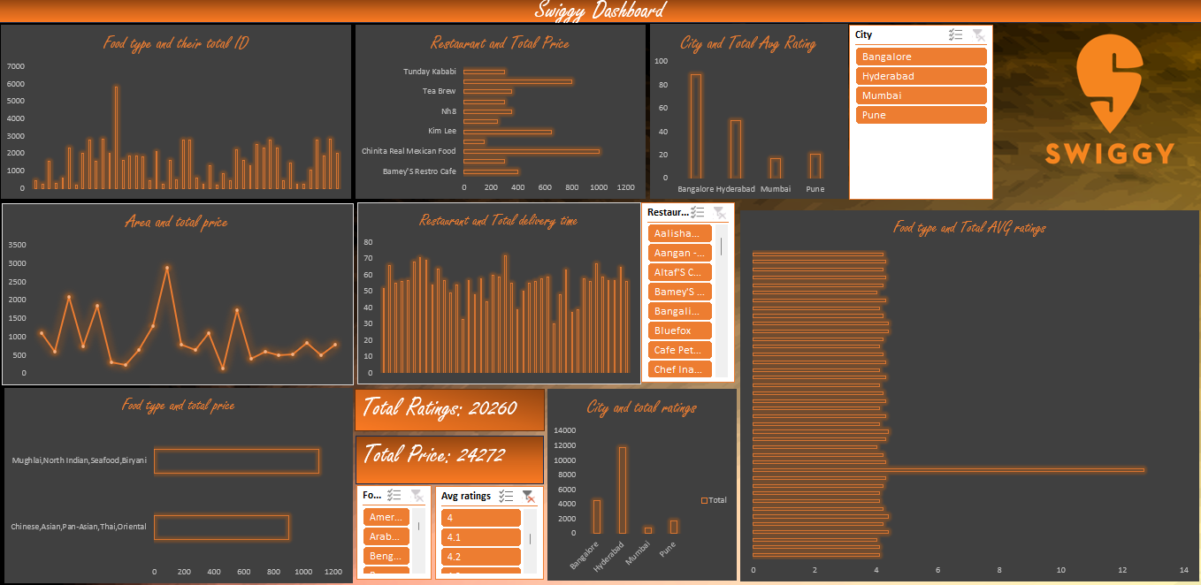
Dashboard analysis

Slide 6
Dashboard analysis (CONTD)
The dashboard displays food type along with the total count of IDs and showcases restaurants with their respective total prices.
It also highlights cities and their average ratings, along with both the average and total prices for each location.
Additionally, the dashboard presents restaurants with their total delivery time and shows food types with their total average ratings.
Lastly, it features a view of food types alongside total prices, as well as cities with their corresponding total pricing details.

Slide 7
Question 1 to 3 analysis
We need to know whether any ID is repeative for the food type. Please display it in the dashboard . Based on this we have shown the ID and their food type
Can you show the high price range restaurant? This questions helps to solve more than 600
We want to know how is our Bangalore restaurant doing in their market. Can you show the rating?
To conduct this question, we have focused on showing the city and total rating.

Slide 8
Question 4 to 6 analysis
We are willing to expand our services in other area as well. Can you display the existing area and their price? To form this dashboard, we have used the area and total price to show the visualization
We need to know which restaurant is having the highest delivery time so that we can find the remedy to solve the problem. To show this we have used the restaurant and showed the delivery time.
We want to know which food type have rating higher than 4. We have focused on having food type and show the avg ratings for the food in the graph
Now to make sure that the ratings are higher than 4 we have used the slicer for this.

Slide 9
Question 7 and 10 analysis
Show the city and the total rating we have in that city. For this we have displayed the data of the city and their total ratings in the city.
We need to know the most expensive dish that we have delivered from the restaurant and which is above 900. for this we have used the food type and total price
Also, we have added the slicer that would show the max price products
Show the sum of rating and total price. This question was show to understand the total number of ratings that are available which signifies the customer support along with the total price which would help the company to set their average price for the upcoming years

Slide 10


